Slide 1

Exploring telegram and Discord for OSINT
An OSINT Primer

Slide 2
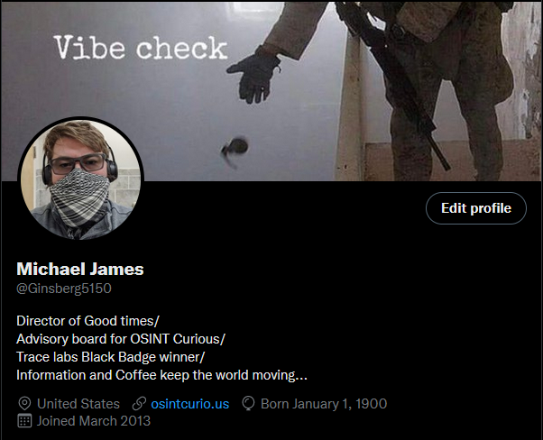





WHOAMI

Slide 3
Disclaimer!!
This talk may include OSINT, SOCMINT and deep web subjects. We fully understand that not all will be allowed to use sock puppets, run code or authenticate to a platform. We will advise workaround where possible. The goal of this talk is to expose the use case and the information that can be gathered from these platforms. Please feel free to reach out with any additional question or requests.
MGMT.

Slide 4
What we do before matters…
What is the goal of the research?
Are we researching groups, targets or data? (findings, data trade, malicious postings, company mentions?)
Are we joining the groups?
Is the goal to research from the outside a channel or server?
Are we linking a device to the application?
Are we downloading information or user details?

Slide 5
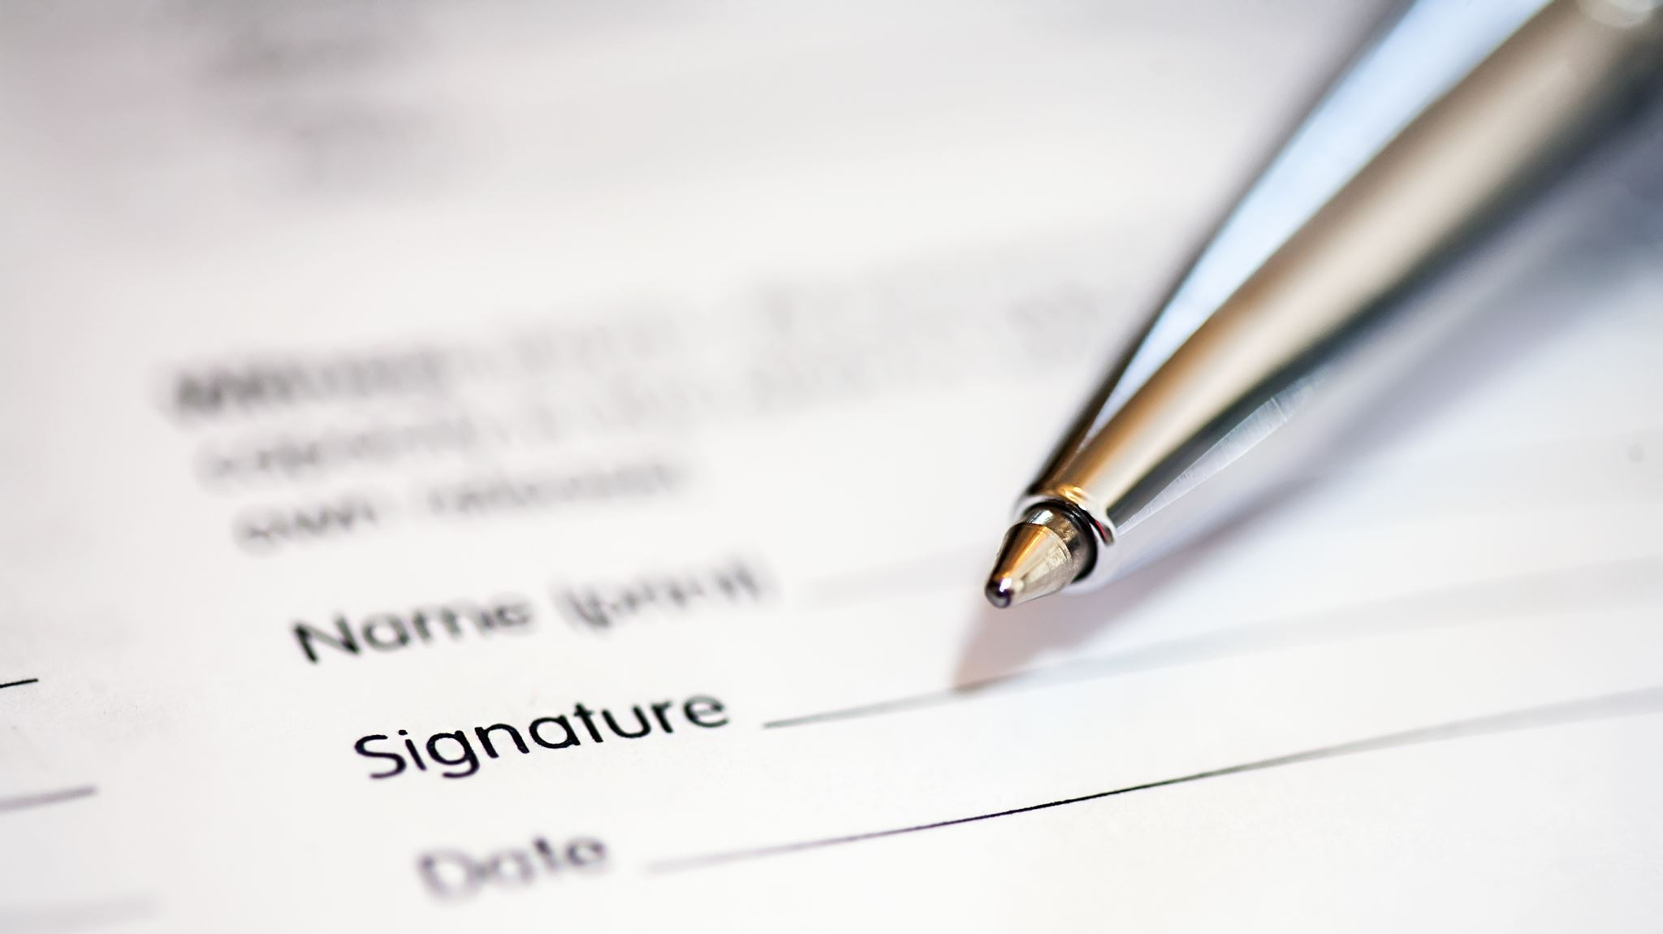
Agenda for the talk:
We will discuss the use case of each platform
We will look at the platform from:
3rd party view
Unauthenticated
Authenticated
What is the information detail we want to gather?
Pivoting into and out of the platform.
Advanced topics
Python scripting for the platform

Slide 6
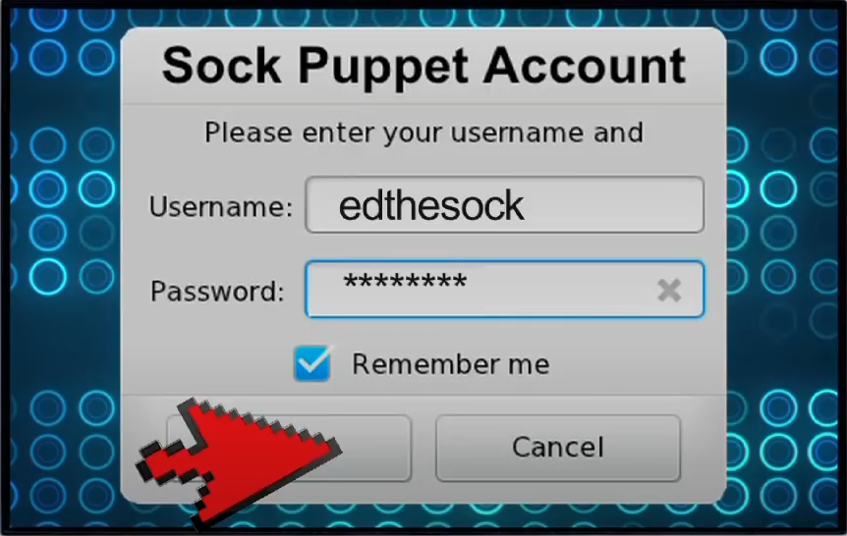
OPSEC:
Depending on your ability to research, there are certain things you might be able to do:
Develop a sock puppet account
Run code
Interact with users
Post in a thread to mature a sock account or gain additional information

Slide 7

Telegram

Slide 8

Telegram: What it is?
Telegram is a messaging application that allows people to talk privately or join public and private channels to share information in feeds.
What do we specifically look for on Telegram?
Malicious actor selling or promote services.
Ransomware groups leak data.
Carding sales
Human trafficking sales

Slide 9
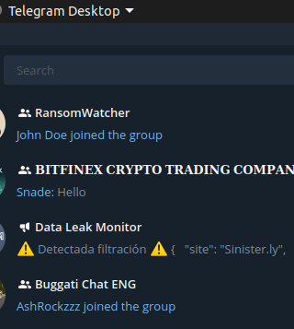
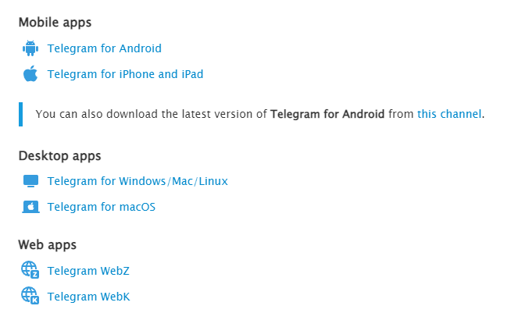
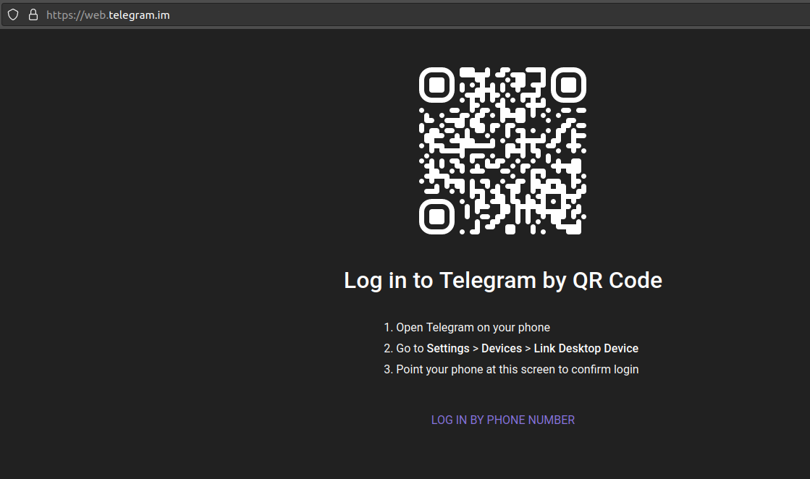
How to access the platform…

Slide 10
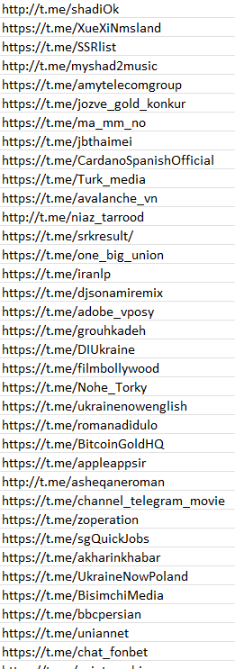
Access to the platform
You will need a phone number to access the platform directly.
Mobile application – Android and iPhone
Browser Application
Desktop Application
External access:
Google Dorks
Search Engines
Other Social Media platforms
Forum Signature posts
GitHub

Slide 11
Google Dorks and Programmable search engine:
Programmable Search Engine:
WeVerify:
‘https://cse.google.com/cse?cx=006976128084956795641:ad1xj14zfap’
Francesco Poldi:
https://cse.google.com/cse?cx=004805129374225513871%3Ap8lhfo0g3hg
Telegago
https://cse.google.com/cse?q=%2B&cx=006368593537057042503%3Aefxu7xprihg
Google Dorks:
site:t.me/joinchat
site:t.me/*
+ instant data scraper
site:telegram.me

Slide 12
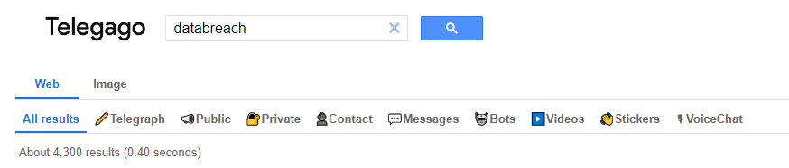
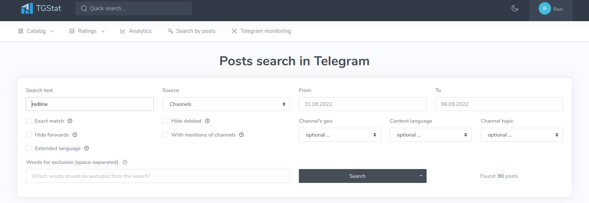
External Discovery - Telegram
https://intelx.io/tools?tab=telegram
https://tgstat.com/

Slide 13


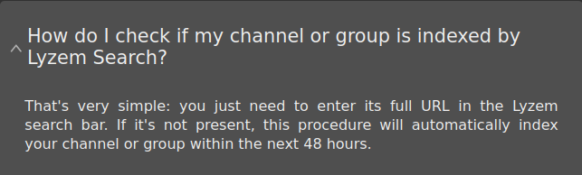
External Discovery - Telegram
https://lyzem.com
https://tlgrm.eu/channels

Slide 14
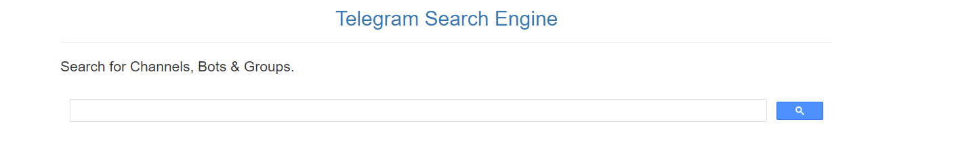

External Discovery - Telegram
https://xtea.io/ts_en.html#gsc.tab=0
Social Media lookup
r/TelegramGroups/

Slide 15
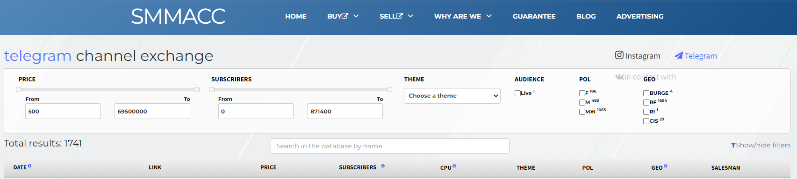
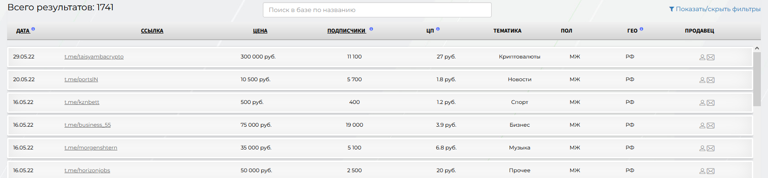
External Discovery - Telegram
smmacc.ru/shop/telegram.html

Slide 16
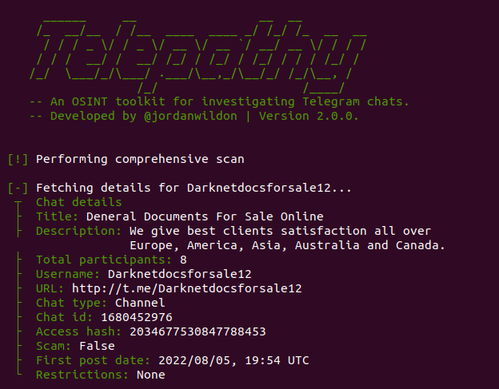
External Discovery - Telegram
Developed by Joran Wildon
Good tool and just had an update to V2

Slide 17
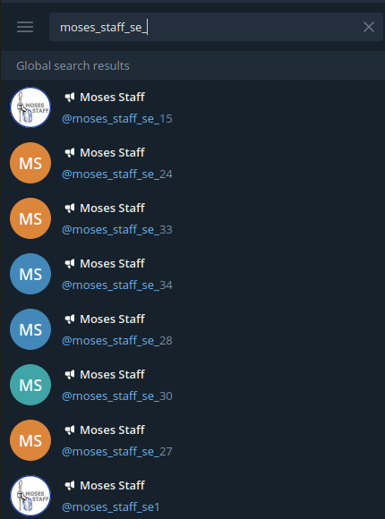
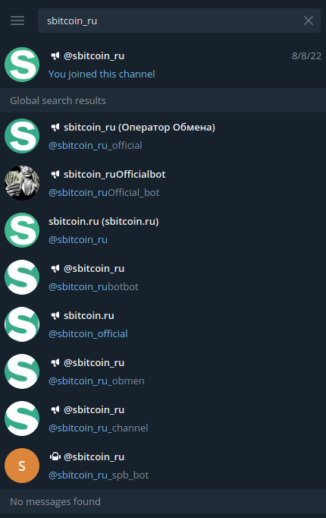
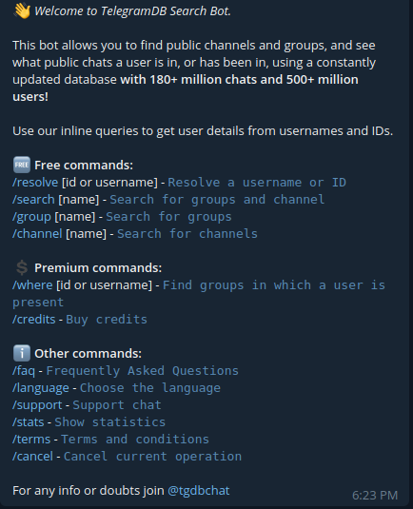
Internal Search - Telegram
Using Bots can be helpful but think about who owns the bot.

Slide 18
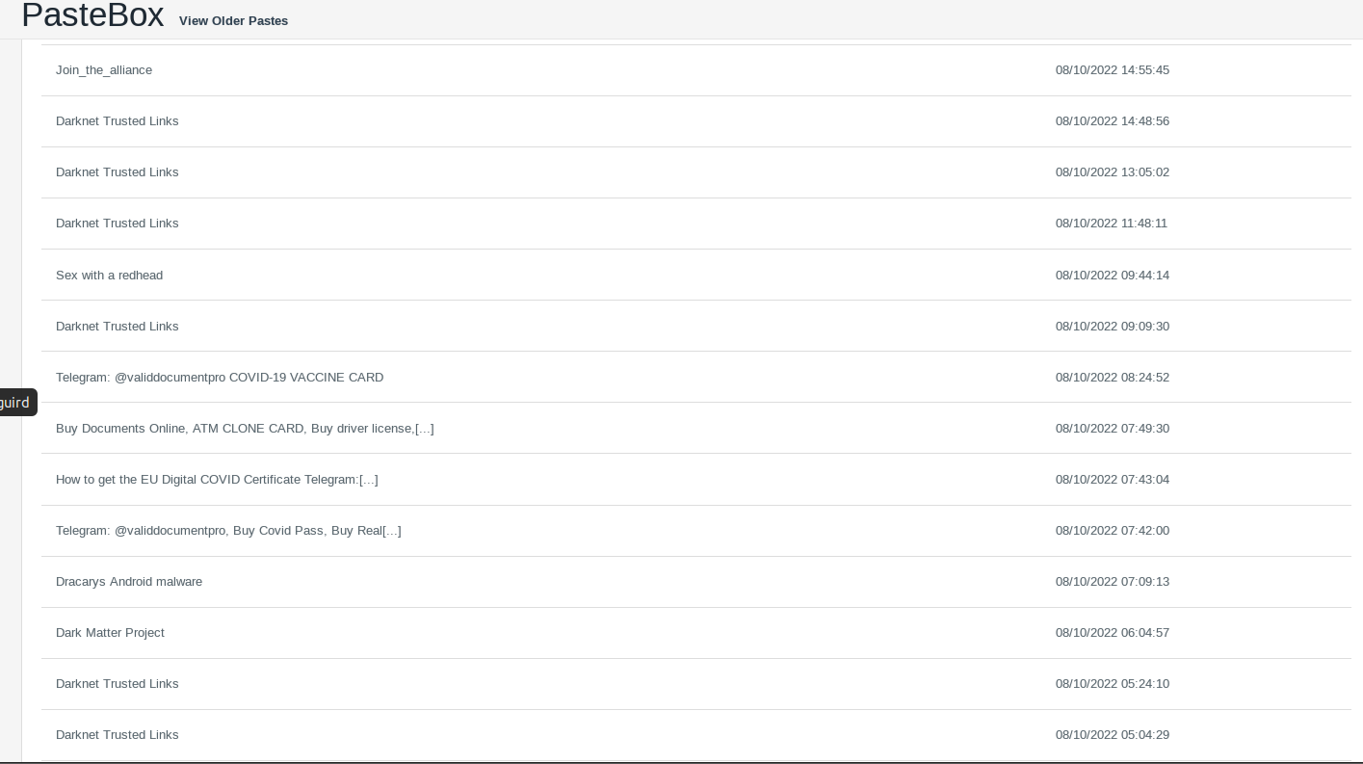

Slide 19
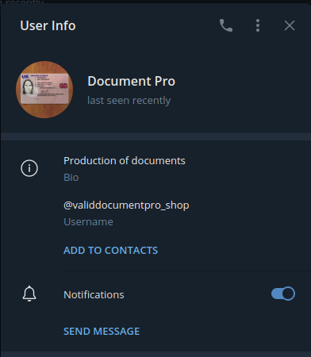
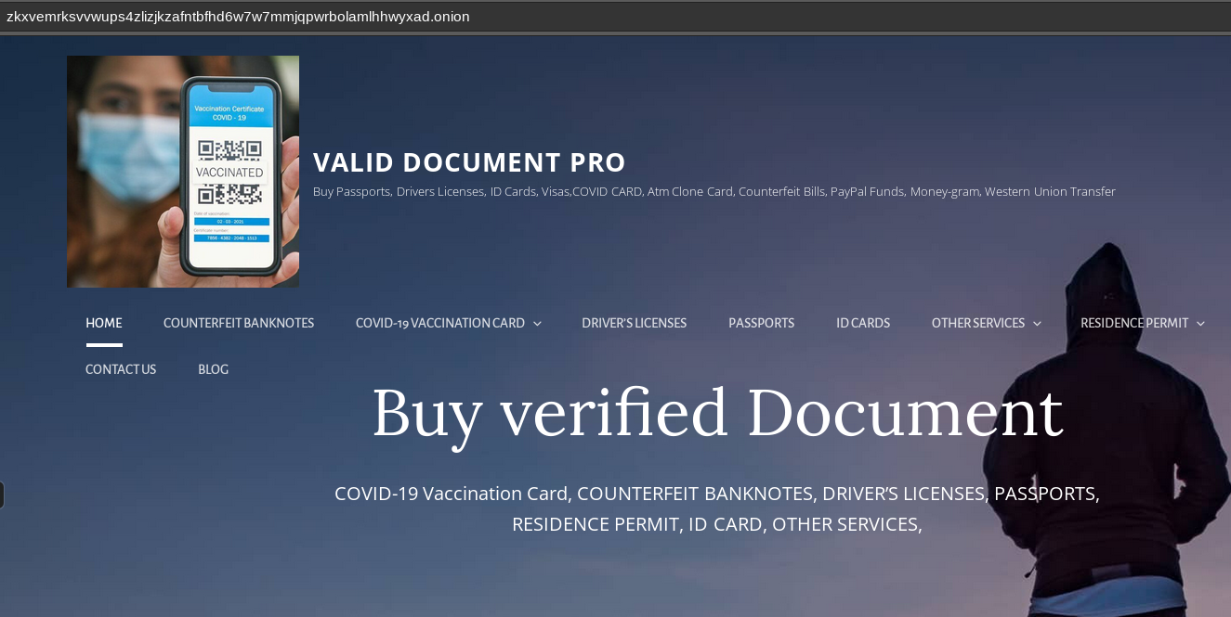
OSINT profile
What’s app:+44 7418 601429
email: deepmarketplug@protonmail.com
Telegram: @validdocumentpro
Wickr : validdocumentpr
Our website…http://zkxvemrksvvwups4zlizjkzafntbfhd6w7w7mmjqpwrbolamlhhwyxad.onion/

Slide 20
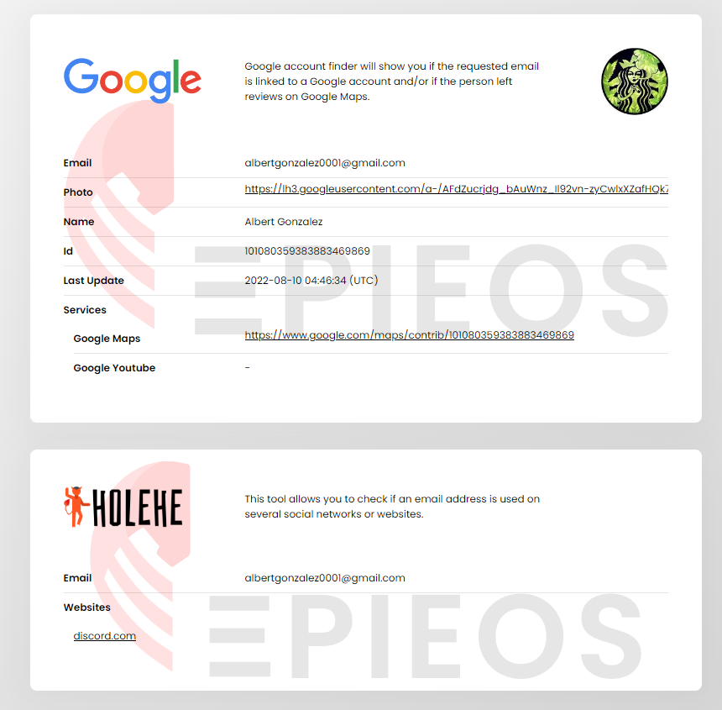
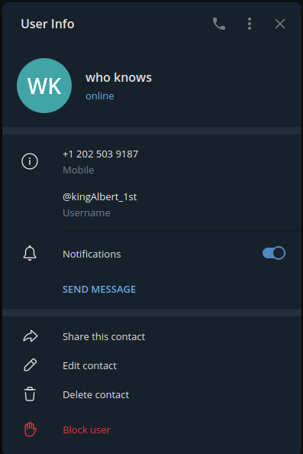
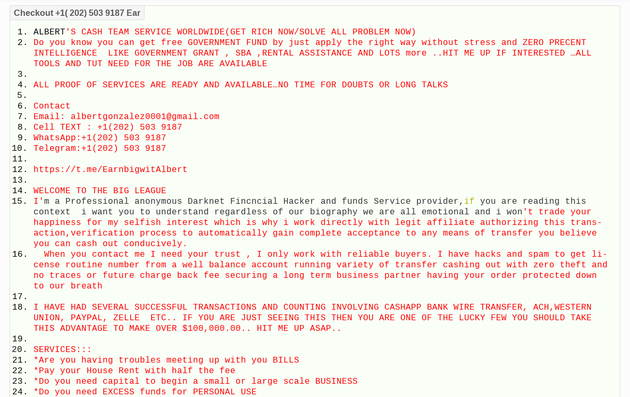
OSINT profile

Slide 21

Discord

Slide 22
How do we track the servers we want to review?
How Discord creates its servers:
Logging into the network is the Heartbeat
The guild ID is the server that you are joining
The Channel ID is the channel that you are viewing
The message ID is the message that you are writing or looking at.
Why this is important? These are events and not text.
You can reply to a message in thread, and it is part of that message ID.

Slide 23
What value can we get out of Discord?
Information points to capture from Discord:
Username
Discriminator
Discord ID – possibly the most important
joined_at
Badges
Roles
status
Client_status
public_flags
Bot status
premium_since
Outside tasks (listening to spotify, playing $game, etc)

Slide 24
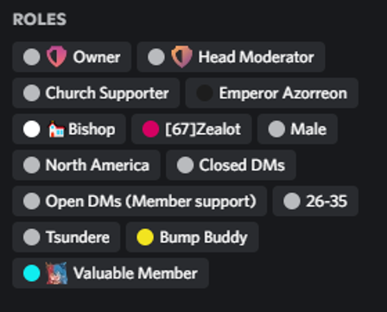
Discord basics
Discord,com/channels/669772365751910401 {GUILD ID }/669772365751910404{CHANNEL ID}
‘871965032802549770’
: {'member': {'user': {'username': '𝔎𝔢𝔦𝔫𝔓𝔲𝔩𝔩𝔢𝔯𝔪𝔞𝔫', 'public_flags': 256, 'id': '645591282089066496', 'discriminator': '4591', 'bot': False, 'avatar': '41a421b89f066868a4d8218b54f40946'}, 'roles': ['863718368971325440'],
'presence': {'user': {'id': '645591282089066496'}, 'status': 'online', 'game': {'type': 0, 'timestamps': {'start': 1661538435322}, 'session_id': None, 'platform': 'ps4', 'name': 'The Last of Us™ Part II', 'id': '5057a4ecd53d253c', 'flags': 0, 'created_at': 1661538435322, 'assets': {'small_image': 'mp:external/HidN0_2c7zR0orsnRpjqG0kLm5NzRu16nRy83LE_TR4/https/image.api.playstation.com/vulcan/img/rnd/202010/2618/w48z6bzefZPrRcJHc7L8SO66.png'}}, 'client_status': {'mobile': 'online', 'desktop': 'online'}, '}}]}, 'premium_since': None, 'pending': False, 'nick': None, 'mute': False, 'joined_at': '2022-06-26T14:34:37.473000+00:00', 'flags': 0, 'deaf': False, 'communication_disabled_until': None, 'avatar': None

Slide 25
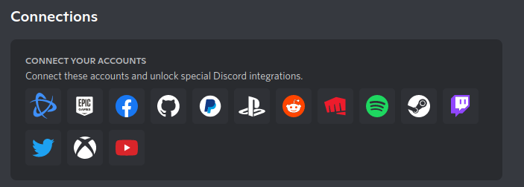
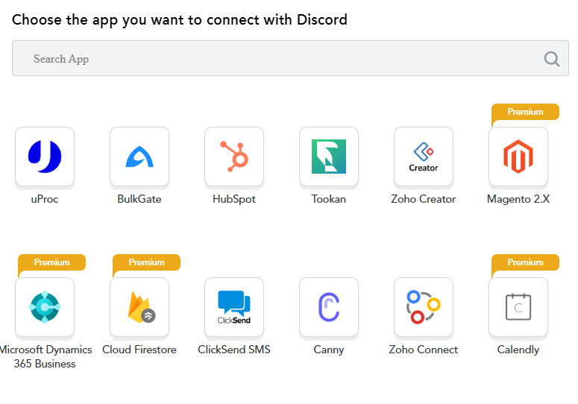
Native support – growing everyday
https://www.appypie.com/connect/apps/discord/integrations
3rd party intergrations

Slide 26
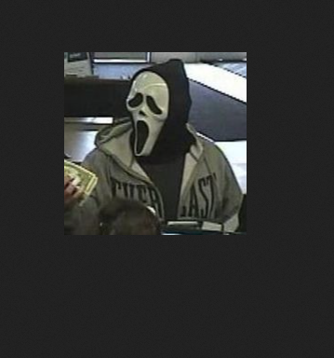
Avatar discovery API
https://cdn.discordapp.com/avatars/645591282089066496/41a421b89f066868a4d8218b54f40946.png?size=1024

Slide 27

Where do we start?
Do we have a target or are we researching communities?
Are we looking into specific users?
Do we have a username or a discord ID?

Slide 28
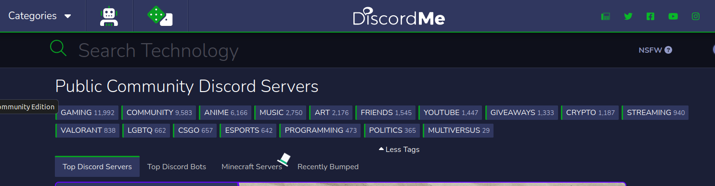
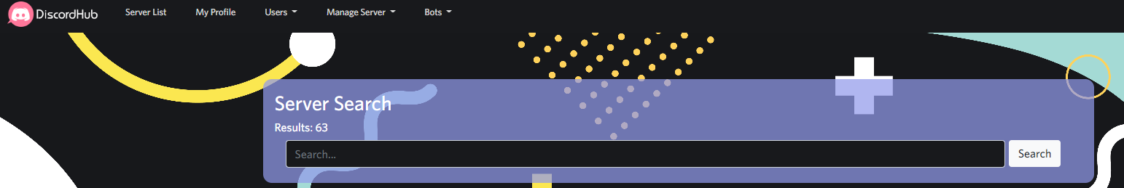
Discord.me
Discordhub.com

Slide 29
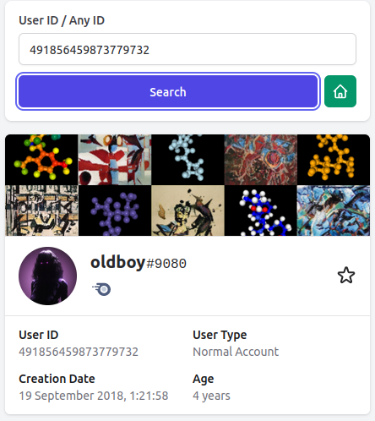
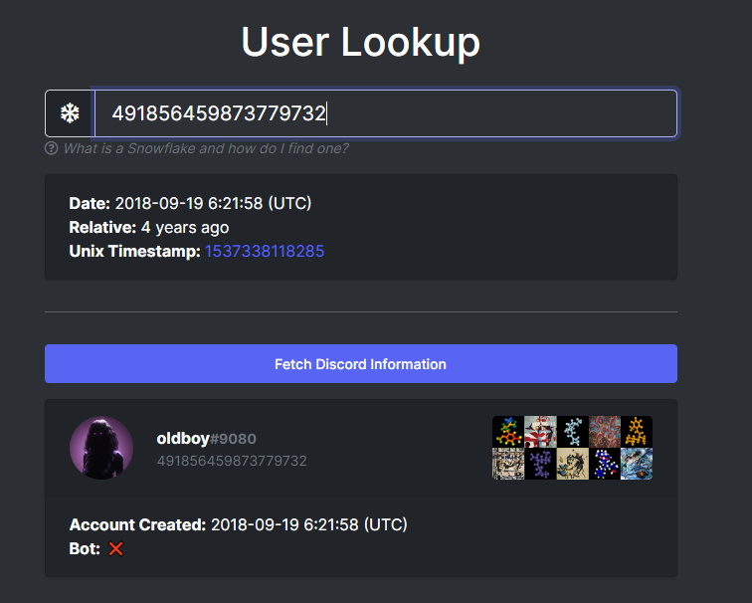
External Search - Discord
Discord ID (snowflake) lookup
Lookup.guru
discordlookup.com/user

Slide 30
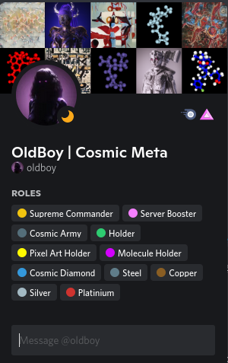
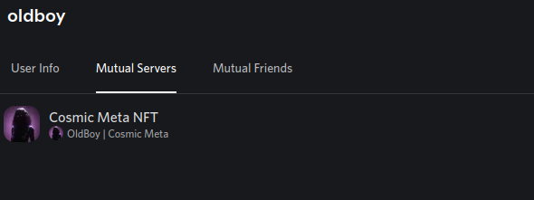
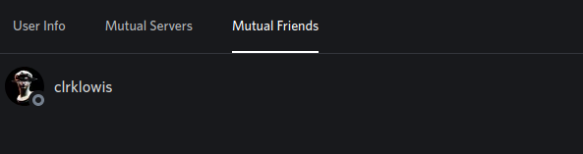

Slide 31

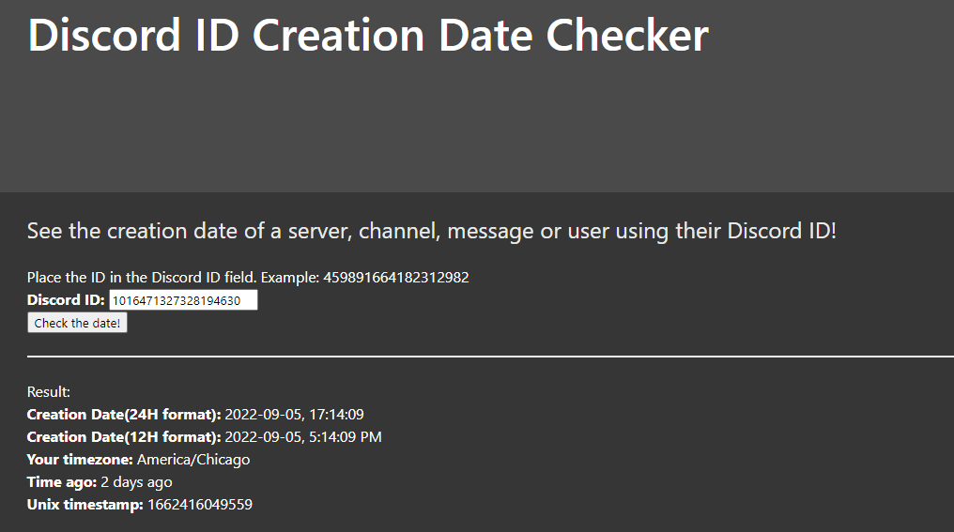
1016471327328194630 – message ID
https://hugo.moe/discord/discord-id-creation-date.html
External Search - Discord

Slide 32
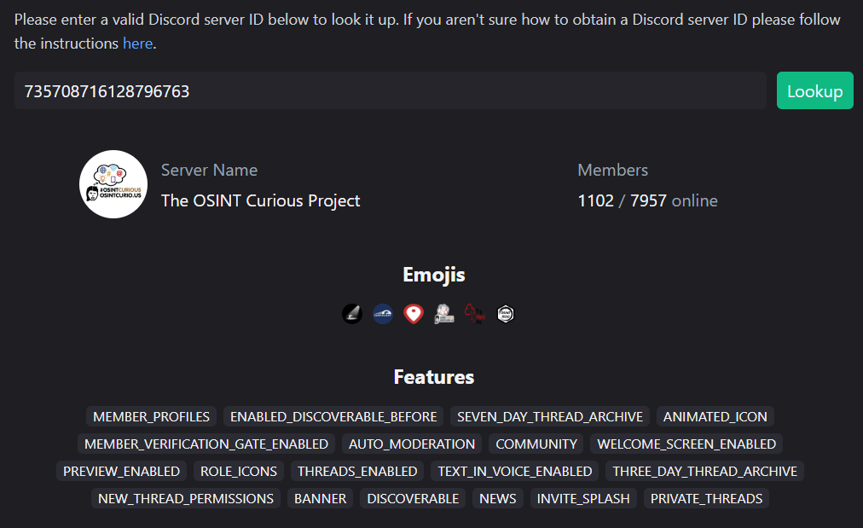
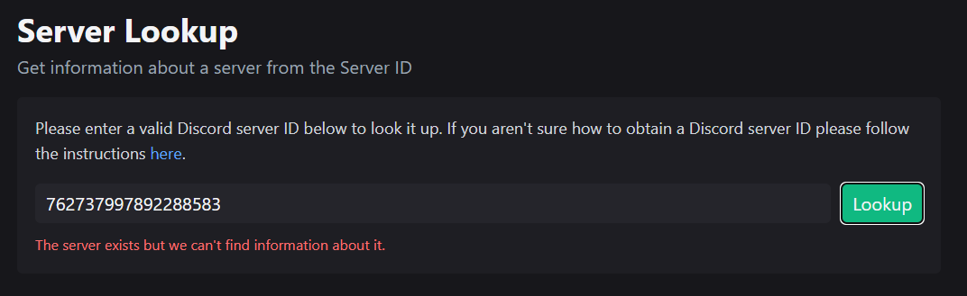
735708716128796763 – Guild ID/Server ID

Slide 33
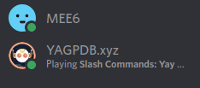
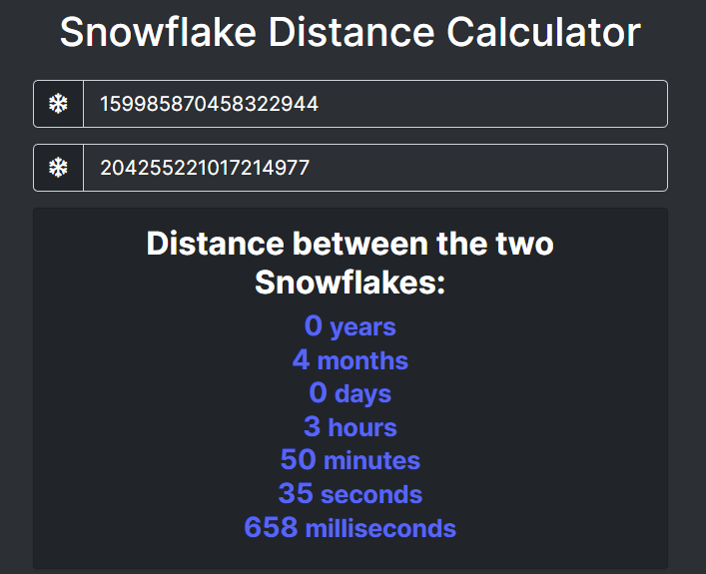
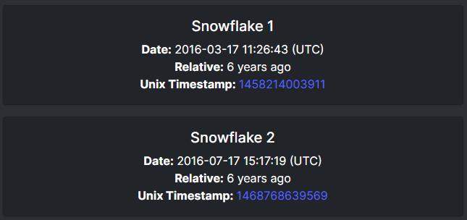

Slide 34
Normal user posting in same channel
[gateway] < {'t': 'RELATIONSHIP_ADD', 's': 78, 'op': 0, 'd': {'user': {'username': 'Prince of Devil', 'public_flags': 0, 'id': '644502603639816208', 'discriminator': '0755', 'avatar_decoration': None, 'avatar': '92e2697796c171dfa00e50ce8fab28ab'}, 'type': 4, 'nickname': None, 'id': '644502603639816208'}}
Bot interaction
'author': {'username': 'MEE6', 'public_flags': 65536, 'id': '159985870458322944', 'discriminator': '4876', 'bot': True, 'avatar_decoration': None, 'avatar': 'b50adff099924dd5e6b72d13f77eb9d7'}, 'attachments': [], 'guild_id': '933387422694273034'}}
DM from someone with readout
[gateway] < {'t': 'MESSAGE_CREATE', 's': 55, 'op': 0, 'd': {'type': 0, 'tts': False, 'timestamp': '2022-09-05T22:14:09.559000+00:00', 'referenced_message': None, 'pinned': False, 'nonce': '1016471324291235840', 'mentions': [], 'mention_roles': [], 'mention_everyone': False, 'id': '1016471327328194630', 'flags': 0, 'embeds': [], 'edited_timestamp': None, 'content': 'thank you very much', 'components': [], 'channel_id': '1016461614825881713', 'author': {'username': 'oldboy', 'public_flags': 0, 'id': '491856459873779732', 'discriminator': '9080', 'avatar_decoration': None, 'avatar': 'beb573e380edcfa7a114995ad194081f'}, 'attachments': []}}
> guild None channel 1016461614825881713 | oldboy#9080: thank you very much

Slide 35

Additional resources for the talk:
Github.com/ginsberg5150

Slide 36
Questions?
QOMPLX.com
OSINTCurio.us
SecKc.org

